Slide 1
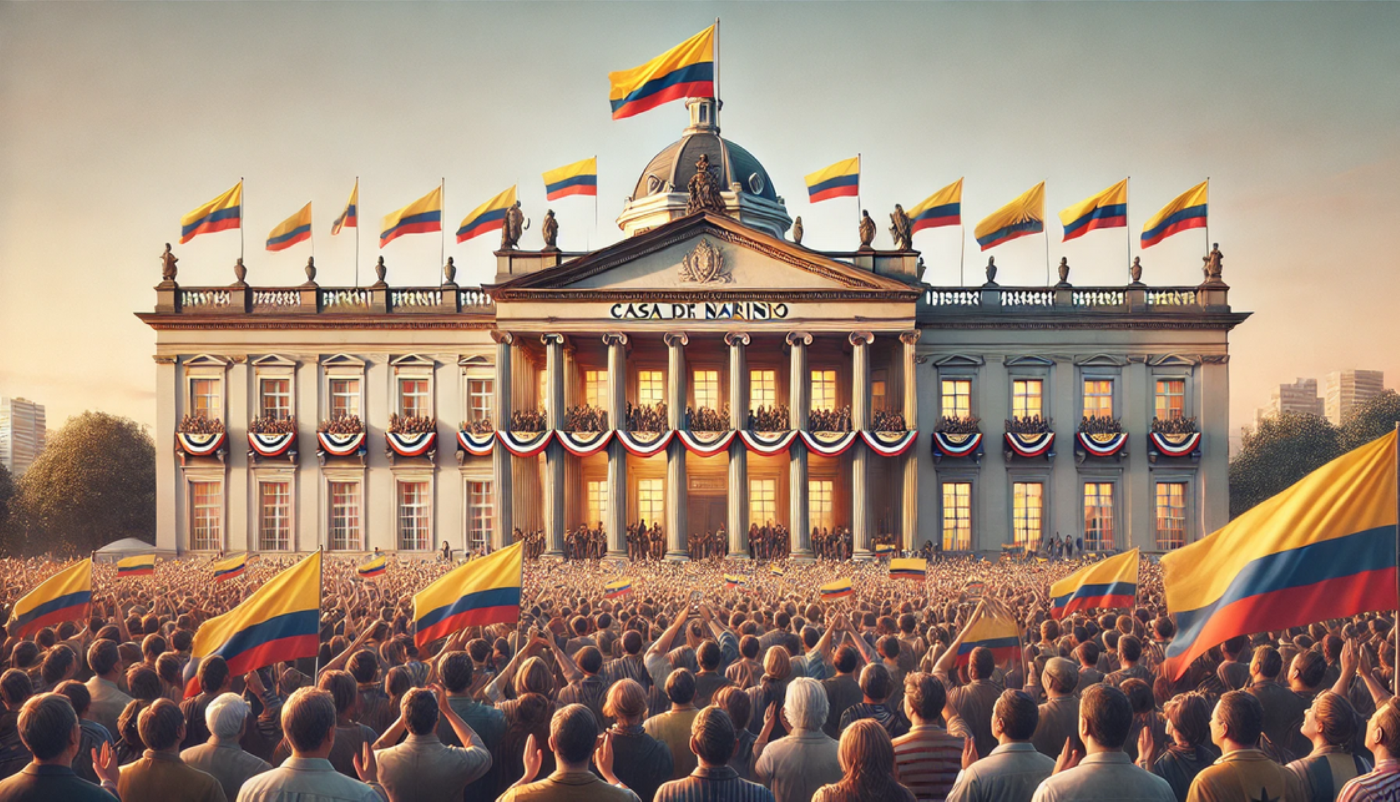
Will you be able to save
the Colombian Democracy?

Slide 3
